Slide 1
Mendel Laws

Slide 2
Life of Mendel
Johann Greogar Mendel, 1822, Silesia
Father name: Anton, a poor family, crop sharing family
Two Sister Victoria and Teresa, he was the youngest
Mendel was weak, not robust, most time sick, not fit for farming, so he was sent to boarding school to become a teacher

Slide 3
1838, father lost his legs, so he had to come back to look the farm, he was a patient of melancholia (current day depression) and went to bed for six months.
Victoria got married and her husband got the farm. Father gave money to Teresa, and Teresa sent Mendel to Brno (Czech republic) to pursue his studies and he joined the monastery of Saint Thomas
Abbot Napp made him a teacher in church school, he was good but the parent complained that he has no credentials

Slide 4
There was a test for teaching credentials which he failed because he has test anxiety
He was sent to Vienna to university, he has three important teachers
Unger, Plant anatomist
Doppler, Physicist
Ettinghousen, Mathematician
He failed the exams, came back, went to bed for six months.

Slide 5
He was made TA and he worked on Blending inheritance (Blending inheritance is important because it give you better results as compared to the species itself). Most of the land around Brno was owned by the church, so the church was interested in blending to make money.
Known: Blending inheritance
Unknown: Chromosome, Mitosis, Meiosis, Ploidy, DNA
Unger was in contact with church, making hybrids
Companies had catalogues providing true varieties plants (we now would say that it is homozygous at all loci)

Slide 6
Vocabulary terms
There are a few important terms you should know before diving into Mendel's Laws.
GENOTYPE = the genes present in the DNA of an organism.
We will use a pair of letters (ex: Tt or YY or ss, etc.) to represent genotypes for one particular trait.
There are always two letters in the genotype because (as a result of sexual reproduction) one code for the trait comes from mama organism & the other comes from papa organism, so every offspring gets two codes (two letters).
Now, turns out there are three possible GENOTYPES –
two big letters (like "TT"), one of each ("Tt"), or two lowercase letters ("tt").

Slide 7
When we have two capital or two lowercase letters in the GENOTYPE (ex: TT or tt) it's called HOMOZYGOUS ("homo" means "the same"). Sometimes the term "PURE" is used instead of homozygous.
When the GENOTYPE is made up of one capital letter & one lowercase letter (ex: Tt) it's called HETEROZYGOUS ("hetero" means "other"). Just to confuse you, a heterozygous genotype can also be referred to as HYBRID. OK?

Slide 8
PHENOTYPE: how the trait physically shows-up in the organism. Examples of phenotypes: blue eyes, brown fur, striped fruit, yellow flowers.
ALLELES = alternative forms of the same gene. Alleles for a trait are located at corresponding positions on homologous chromosomes.

Slide 9
Selection of Traits
Traits Varieties
Seed shape Round Vs wrinkled
Seed color Yellow Vs green
Flower color Purple Vs White
Pod Shape inflated Vs pinched
Flower position Apical Vs terminal
Stem length Long Vs short

Slide 10
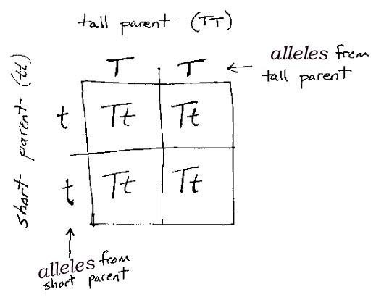
Monohybrid Crosses
Mate Tall plant with Dwarf Plant, in F1 all were Tall
In F2 both tall and dwarf
Ratio 224: 705 = 1:3
F1 told him dominance and recessiveness
He established the dominant and recessiveness for all traits
Yellow seeds with green, F1 yellow (674), in F2 155 (yellow), 353 (both) and 166 (green), so 1:2:1

Slide 11
Mendel first law
Each member of a gene pair has an equal probability of being in a gamete and a gamete gets only 1.
So he should get the credit for discovery of diploidy of peas and haploidy of gametes, although no text mention it.

Slide 12
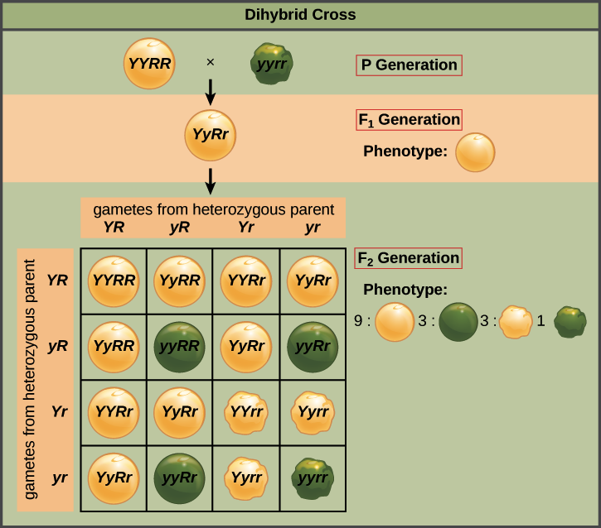
Dihybrid cross
Round green seed with wrinkled yellow
Round yellow: 9
Round green: 3
Wrinkled yellow: 3
Wrinkled green: 1
Round Vs wrinkled: 12:4 = 3:1
Yellow Vs green: 12:4 = 3:1

Slide 13
Mendel Second law
During gamete formation, the segregation of one gene pair is independent of all other.
Feb 21, 1865 philosophical society of natural history of Brno
March 8, 1865, he published his work, got 40 prints, sent to Darwin (he didn't study it, although to understand natural selection, he should have)

Slide 14
Hieracium, Van Nageli, Hieracium produce mitotic flowers so Mendel was not able to prove his observations.
He published his next paper on how he was not able to reproduce his results in Hieracium Anselm Rambousek
Died in 1882
Rediscovery of Mendel Laws
Hugo Devries (He had the paper of Mendel), Carl Carrens (Married the niece of Von Nageli, owned his library)

Slide 15
PROBLEMS ON MENDEL’S LAW OF SEGREGATION
Note: In peas, tall (T) parent habit is dominant over dwarf (t)
1. If a plant homozygous for tall is crossed with one homozygous for dwarf, what will be the appearance of
a. F1 b. F2 c. of the offspring of a cross of f1 with its tall parent d. with its dwarf parent
2. Let the allele for tall be represented by T and the allele for dwarfness by t. What will be the gametes produced by the parent and the height of the offspring (tall or dwarf) from each of the following crosses.
a. TT X Tt b. Tt X tt c. Tt X Tt

Slide 16
3. A tall plant crossed with a dwarf one produces offspring of which about one-half are tall and one-half dwarf, what are the genotypes of the parents.

Slide 17
Problems On Mendel’s Law Of Independent Assortment
Note: In Mouse Rough Coat (R) habit is dominant over Smooth Coat (r) and Black Coat Color (B) is dominant over White Coat Color (b)
1. If a homozygous rough black mouse is crossed with one homozygous for smooth white, what will be the appearance of
a. F1 b. F2 c. of the offspring of a cross of f1 with homozygous rough black mouse d. of the offspring of a cross of f1 with homozygous smooth white
2. How many of the offsprings in F2 generation of Q # 1 will be homozygous for both rough and black character.

Slide 18
3. Seed Color : Yellow = G; Green = g
Seed Shape: Round = W ; Wrinkled = w
If a homozygous Yellow Round is crossed with one homozygous for Green Wrinkled, what will be the appearance of
a. F1 b. F2
c. of the offspring of a cross of f1 with homozygous Yellow Round
d. of the offspring of a cross of f1 with homozygous Green Wrinkled

